Slide 1
Driver Drowsiness and Alcohol Detection

Slide 2
Abstract:
Drowsiness in driving reasons the primary street injuries. Now a day’s drowsiness because of drunken using is growing. If driving force is located to be drowsiness in eyes greater than 5 secs, then the attention blink sensor senses the blink. If the eyes are found to be closed, then the vehicle will be stopped. In our proposed gadget, at the side of drowsiness, alcohol detection is also detected by way of using alcohol sensor. If alcohol is detected in drivers breathe, then the vehicle won’t start. These sensors are interfaced with microcontroller. Led glows in case of alcohol detection and buzzer rings in case of drowsiness detection and pace of the automobile varies on detection of each cases

Slide 3
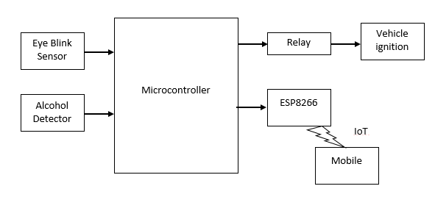
Block Diagram:

Slide 4
HARDWARE REQUIREMENTS :
Ardunio uno
NodeMCU
Vehicle iginition
Eye Blink Sensor
Relay
Alcohol Detector
SOFTWARE REQUIREMENTS :
Arduino
Blynk App
PROGRAMMING LANGUAGES :
Embedded c (Micro controller)

Slide 5
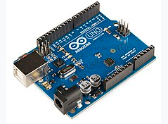
Component description
Arduino uno:
The Arduino uno is a microcontroller board based on the ATmega328P.
It has 14 digital input/output pins (of which 6 can be used as PWM outputs), 6 analog inputs, 1 UART (hardware serial port), a 16 MHz crystal oscillator, a USB connection, a power jack, an ICSP header, and a reset button.
It contains everything needed to support the microcontroller; simply connect it to a computer with a USB cable or power it with a AC-to-DC adapter or battery to get started.

Slide 6
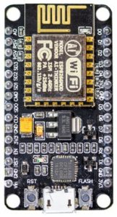
Component description
Node MCU
The NodeMCU (Node MicroController Unit) is an open-source software and hardware development environment built around an inexpensive System-on-a-Chip (SoC) called the ESP8266.
The ESP8266, designed and manufactured by Espressif Systems, contains the crucial elements of a computer: CPU, RAM, networking (WiFi), and even a modern operating system and SDK. That makes it an excellent choice for the Internet of Things (IoT) projects of all kinds.

Slide 7
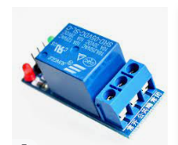
Relay module
A Relay is a simple electromechanical switch. While we use normal switches to close or open a circuit manually, a Relay is also a switch that connects or disconnects two circuits. But instead of a manual operation, a relay uses an electrical signal to control an electromagnet, which in turn connects or disconnects another circuit.
In this project relay is used to supply power to appliances such as light and fan when triggered by NODE MCU

Slide 8
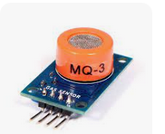
Alcohol Sensor:
The alcohol sensor is technically referred to as a MQ3 sensor which detects ethanol in the air. When a drunk person breathes near the alcohol sensor it detects the ethanol in his breathe and provides an output based on alcohol concentration.

Slide 9
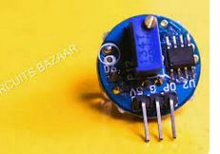
Eye Blink Sensor:
Eye blink Sensor is a relatively simple sensor used to detect eye blinks. It uses a simple infrared sensor to detect if the person's eye is closed and the corresponding data received can further be processed by any logic as required for the application.

Slide 10
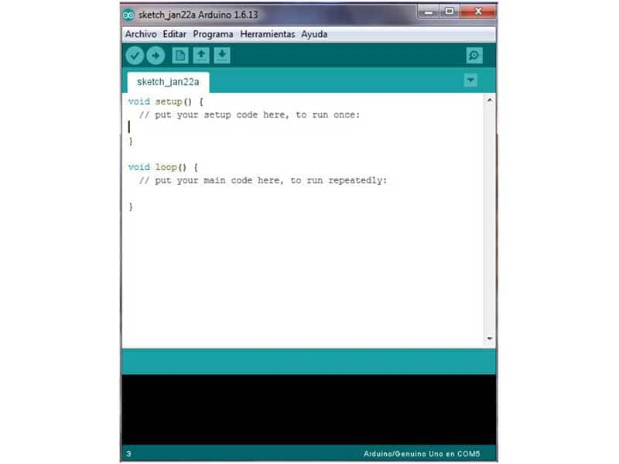
Software : Arduino IDE
The Arduino Integrated Development Environment - or Arduino Software (IDE) - contains a text editor for writing code, a message area, a text console, a toolbar with buttons for common functions and a series of menus. It connects to the Arduino hardware to upload programs and communicate with them.

Slide 11
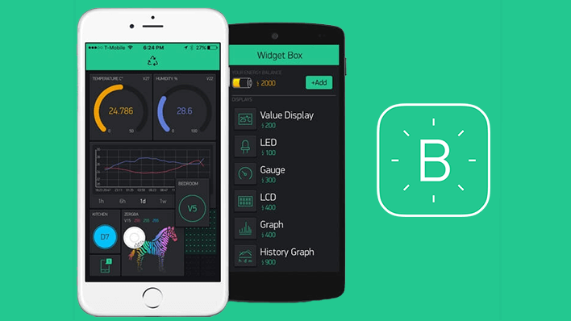
BLYNK APP
BLYNK APP
Blynk is an Internet of Things Platform aimed to simplify building mobile and web applications for the Internet of Things. Easily connect 400+ hardware models like Arduino, ESP8266, ESP32, Raspberry Pi and similar MCUs and drag-n-drop IOT mobile apps for iOS and Android in 5 minutes

